Slide 1
Adaptation to Climate Change: Challenges for Producers in the US Midwest
Eugene S. Takle
Professor
Department of Agronomy
Department of Geological and Atmospheric Science
Director, Climate Science Program
Iowa State University
Ames, IA 50011
Climate Change Webinar
US Department of Agriculture
Washington, DC
7 June 2012

Slide 2
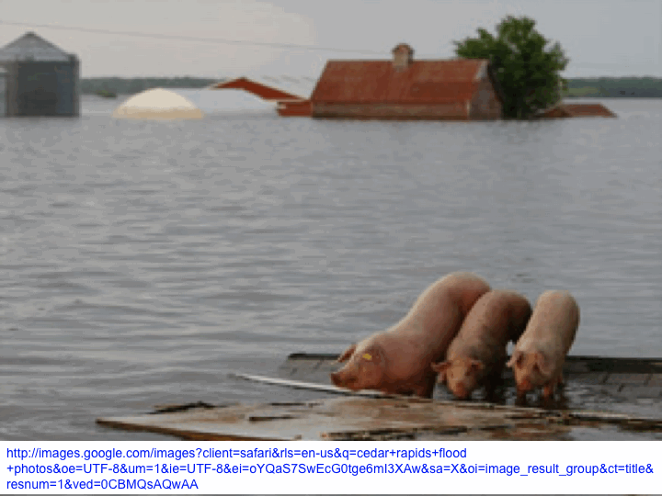
Outline
Recent changes in climate of the Midwest
Producer adaptation to climate change
Farmer beliefs about climate change and where to go for information
Climate-informed decision cycle

Slide 3
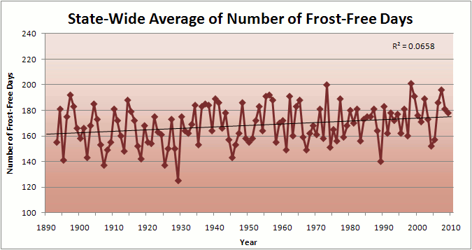
Iowa State-Wide Average Data

Slide 4
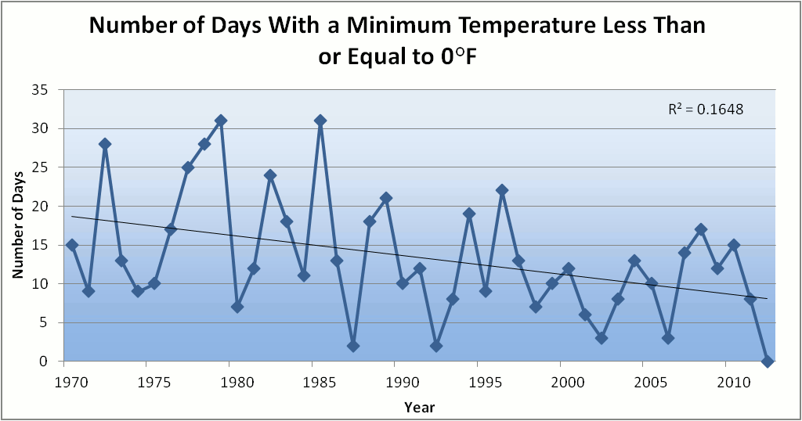
Des Moines Airport Data
Caution: Not corrected for urban heat island effects

Slide 5
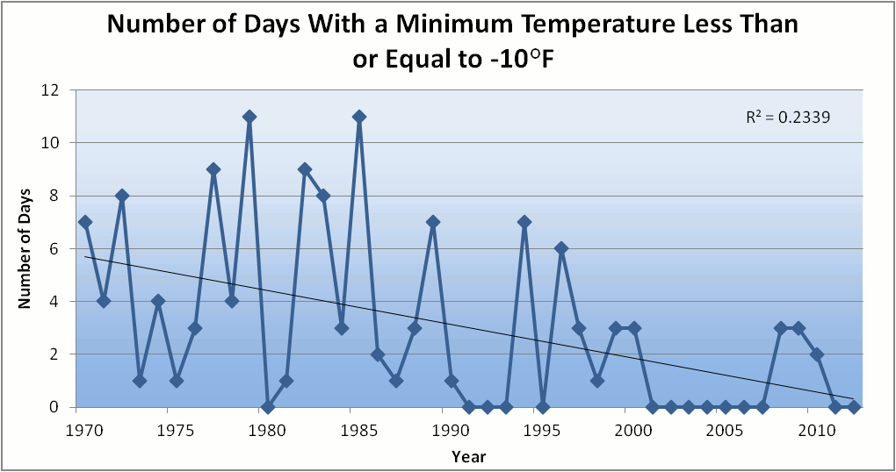
Des Moines Airport Data
Caution: Not corrected for urban heat island effects

Slide 6
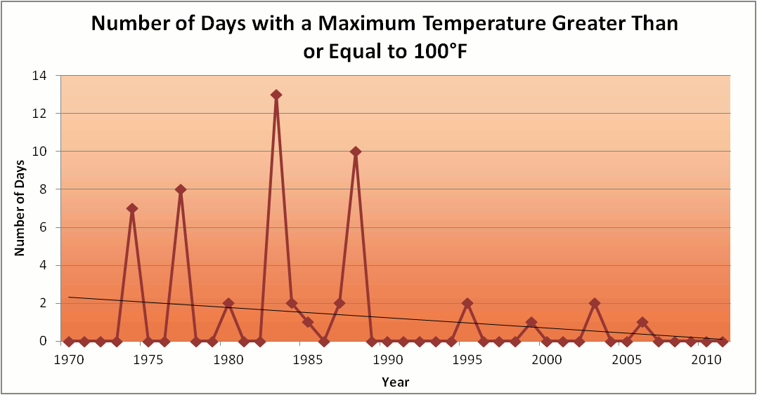
Des Moines Airport Data
1983: 13
1988: 10
1977: 8
1974: 7

Slide 7
Des Moines Airport Data
1983: 13
1988: 10
1977: 8
1974: 7
Only 6 days ≥ 100ºF in the last 23 years

Slide 10
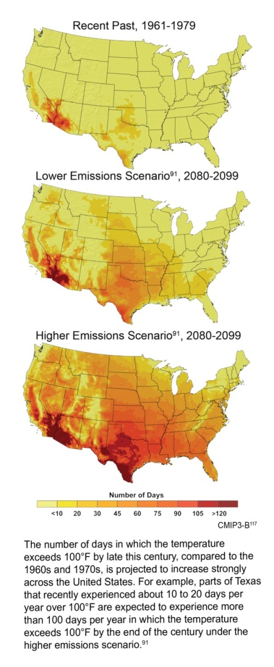
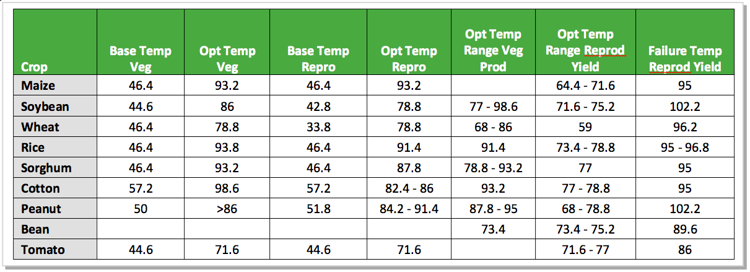
Crop Yield and Grain Quality are Compromised by Temperature Increase
Days/Yr with T>100ºF
Rising daily maximum temperatures increase the likelihood of extended periods with temperatures above the failure point for reproduction (grain production)
Rising nighttime temperatures decrease the quality of grain (corn)

Slide 11
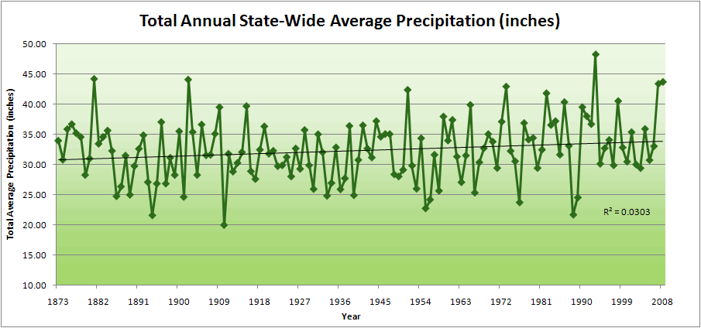
Iowa State-Wide Average Data

Slide 12
Iowa State-Wide Average Data
34.0”
10% increase
30.8”

Slide 13
Iowa State-Wide Average Data
Totals above 40”
2 years
34.0”
10% increase
30.8”

Slide 14
Iowa State-Wide Average Data
Totals above 40”
2 years
8 years
34.0”
10% increase
30.8”

Slide 15
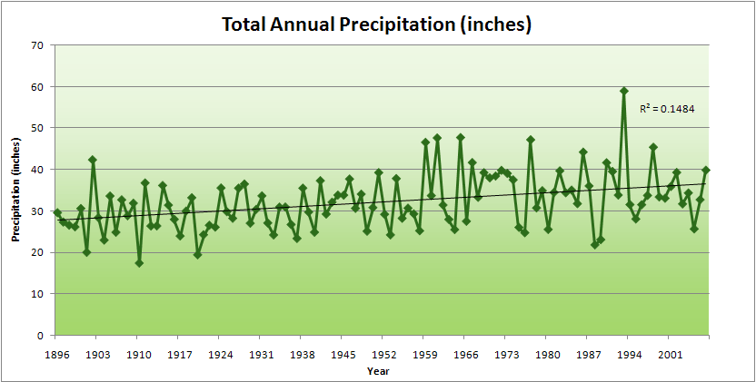
Cedar Rapids Data

Slide 16
Cedar Rapids Data
28.0”
32% increase
37.0”

Slide 17
Cedar Rapids Data
Years with more than 40 inches
11
1
28.0”
32% increase
37.0”

Slide 18
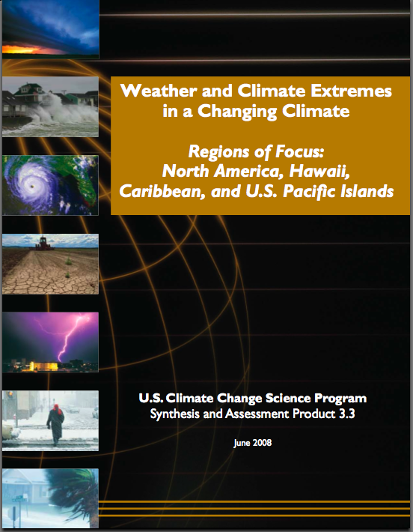
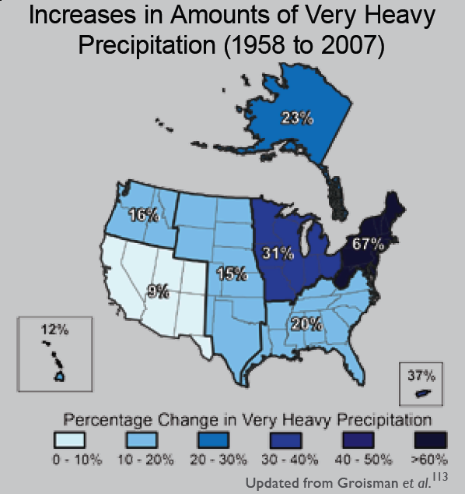
“One of the clearest trends in the United States observational record is an increasing frequency and intensity of heavy precipitation events… Over the last century there was a 50% increase in the frequency of days with precipitation over 101.6 mm (four inches) in the upper midwestern U.S.; this trend is statistically significant “
Karl, T. R., J. M. Melillo, and T. C. Peterson, (eds.), 2009: Global Climate Change Impacts in the United States. Cambridge University Press, 2009, 196pp.

Slide 19
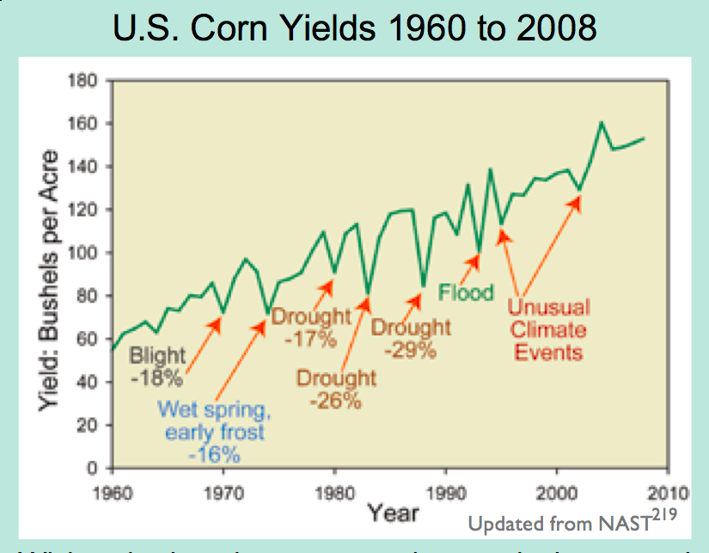
Extreme Events are Usually Detrimental

Slide 20
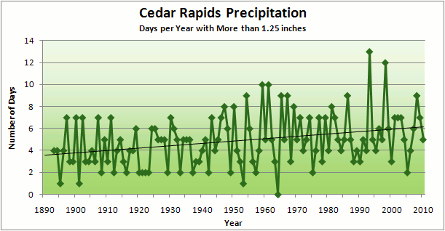
Cedar Rapids Data
3.6 days
67% increase
6.0 days

Slide 21
Cedar Rapids Data
Number of Years with More than 8 Occurrences
0
9
3.6 days
67% increase
6.0 days

Slide 23
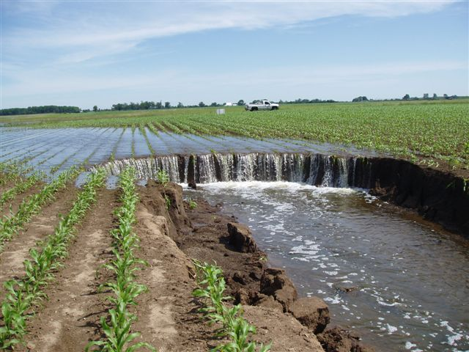
Photo courtesy of RM Cruse

Slide 24
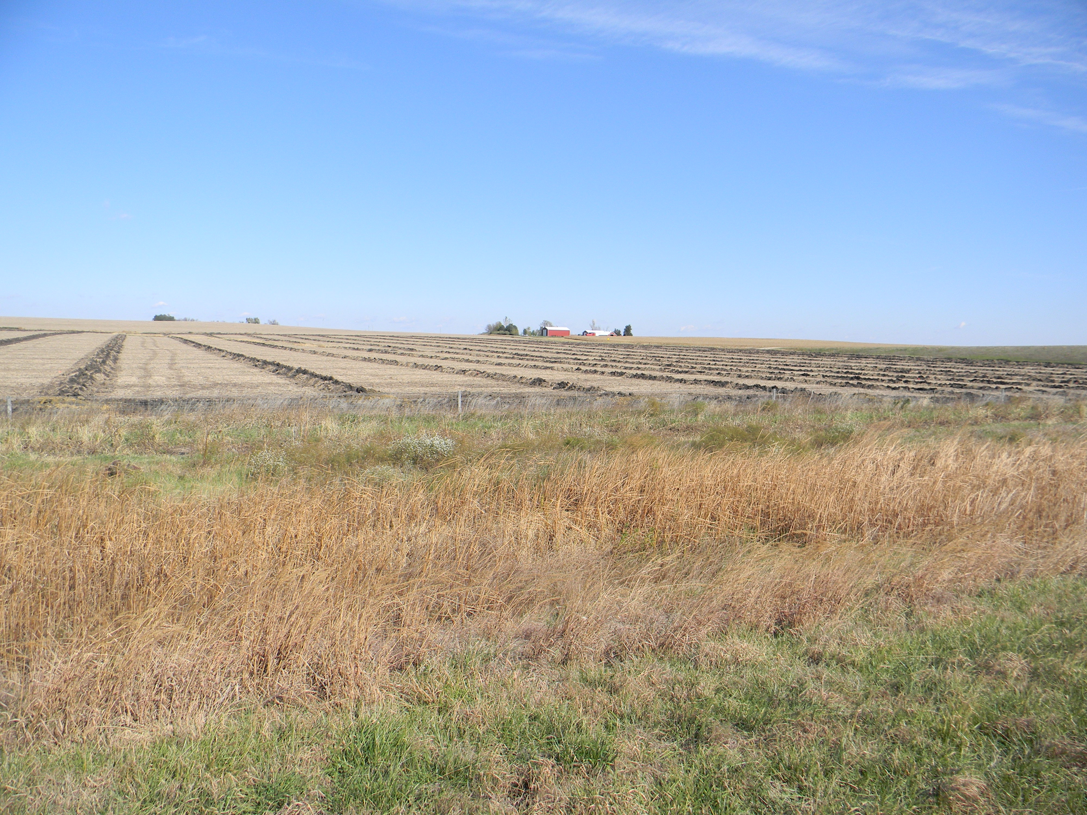

Slide 25
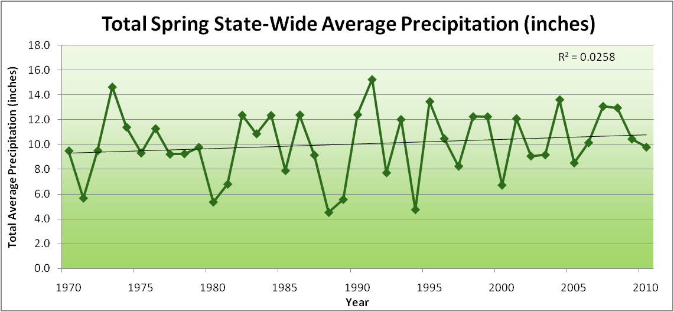
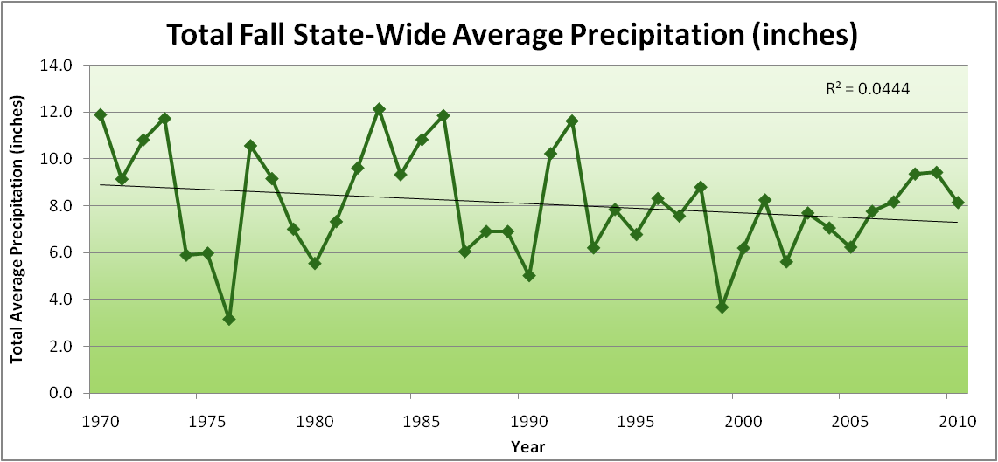
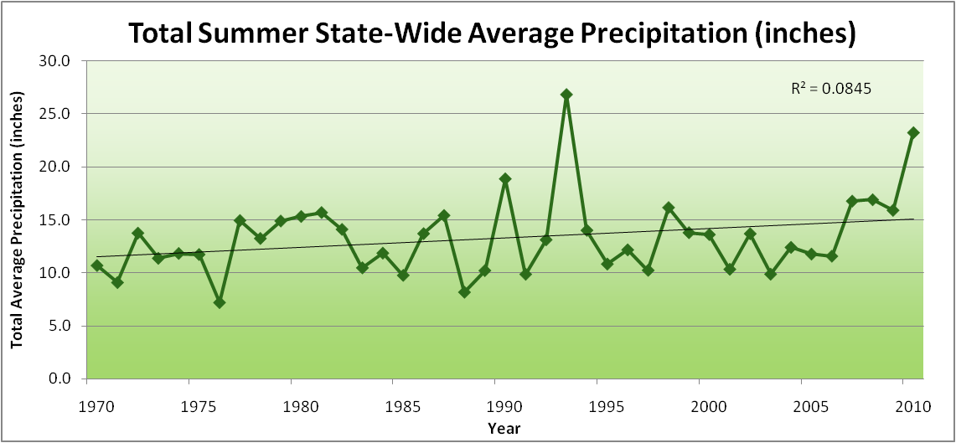
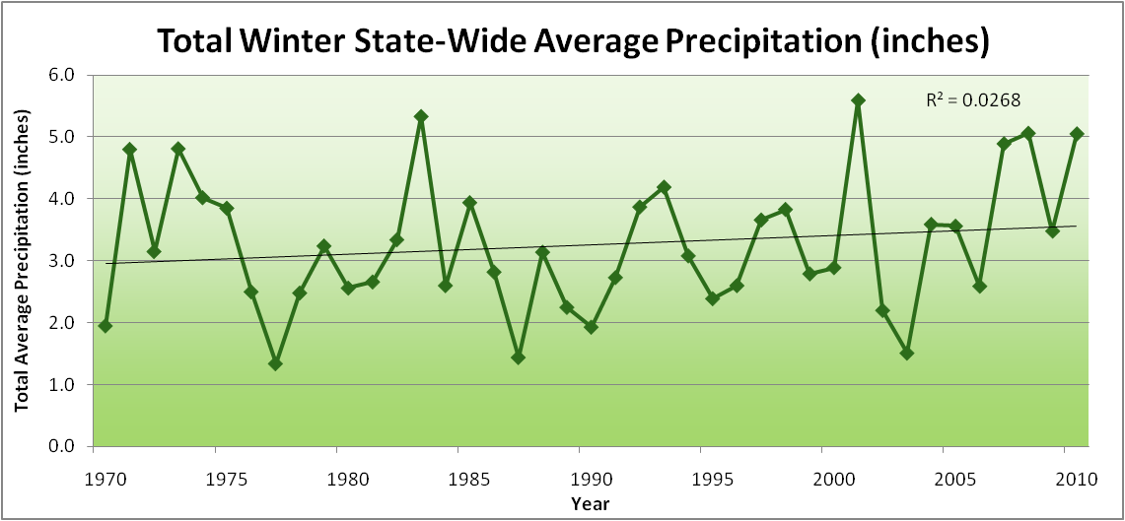
Amplification of the Seasonality of Precipitation
Spring
Fall
Summer
Winter

Slide 26
Amplification of the Seasonality of Precipitation
Spring
Fall
Summer
Winter

Slide 27
Amplification of the Seasonality of Precipitation
Spring
Fall
21.2 => 25.3 inches (22% increase)
12.1 => 10.5 inches (13% decrease)
Summer
Winter

Slide 28
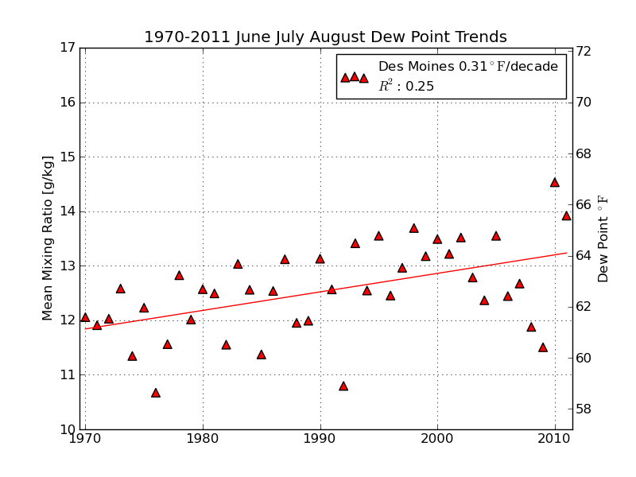
Mean Summer (JJA) Dew-Point Temperatures for Des Moines, IA
Rise of 3ºF in 42 years
12% rise in water content in 42 years

Slide 29
Iowa Agricultural Producers are Adapting to Climate Change:
Longer growing season: plant earlier, plant longer season hybrids, harvest later
Wetter springs: larger machinery enables planting in smaller weather windows
More summer precipitation: higher planting densities for higher yields
Wetter springs and summers: more subsurface drainage tile is being installed, closer spacing, sloped surfaces
Fewer extreme heat events: higher planting densities, fewer pollination failures
Higher humidity: more spraying for pathogens favored by moist conditions. more problems with fall crop dry-down, wider bean heads for faster harvest due to shorter harvest period during the daytime.
Drier autumns: delay harvest to take advantage of natural dry-down conditions, thereby reducing fuel costs
HIGHER YIELDS!!
Is it genetics or climate? Likely some of each.

Slide 30
Impacts of Climate Change on Animal Agriculture
Decreased weight gain in meat animals
Decreased egg production in poultry operations
Decreased milk production in dairy operations
Decreased breeding success in animal agriculture
Increase in sickness and disease

Slide 31
Results of Iowa Extension Service Annual Farm Survey*
2011 Iowa Farm and Rural Life Poll, an annual survey of Iowa farmers: 1,276 farmers
While 68% of Iowa farmers believe climate change is occurring, less than 45% believe humans are at least half responsible. Because of this a majority of farmers see little need to mitigate the causes of climate change.
Majority (53%) of Iowa farmers consider agriculture extension to be a trusted source of information on climate change
Less than a majority (41%) trust scientists on climate change (although scientists are second to extension personnel as a trusted source)
*https://store.extension.iastate.edu/ItemDetail.aspx?ProductID=13717

Slide 32
Results of Iowa Extension Service Annual Farm Survey*
2011 Iowa Farm and Rural Life Poll, an annual survey of Iowa farmers: 1,276 farmers
While 68% of Iowa farmers believe climate change is occurring, less than 45% believe humans are at least half responsible. Because of this a majority of farmers see little need to mitigate the causes of climate change.
Majority (53%) of Iowa farmers consider agriculture extension to be a trusted source of information on climate change
Less than a majority (41%) trust scientists on climate change (although scientists are second to extension personnel as a trusted source)
*https://store.extension.iastate.edu/ItemDetail.aspx?ProductID=13717

Slide 33
Results of Iowa Extension Service Annual Farm Survey*
2011 Iowa Farm and Rural Life Poll, an annual survey of Iowa farmers: 1,276 farmers
While 68% of Iowa farmers believe climate change is occurring, less than 45% believe humans are at least half responsible. Because of this a majority of farmers see little need to mitigate the causes of climate change.
Majority (53%) of Iowa farmers consider agriculture extension to be a trusted source of information on climate change
Less than a majority (41%) trust scientists on climate change (although scientists are second to extension personnel as a trusted source)
As climate change intensifies and adaptation
becomes more of a challenge,
producers will look to USDA for help
*https://store.extension.iastate.edu/ItemDetail.aspx?ProductID=13717

Slide 34
Related Activities
Climate and Corn-based Cropping System CAP (CSCAP). USDA NIFA project 2011-68002-30190. http:/www.sustainablecorn.org: developing science-based knowledge (on carbon, nitrogen, and water) that addresses climate mitigation and adaptation, informs policy development, and guides on-farm, watershed level and public decision making in corn-based cropping systems
Useful to Usable (U2U): Transforming Climate Variability and Change Information for Cereal Crop Producers. USDA NIFA project 2011-68002-30220. http:/www.AgClimate4U.org: Improving the resilience and profitability of farms amid variable climate changes by providing stakeholders with enhanced decision support tools

Slide 35
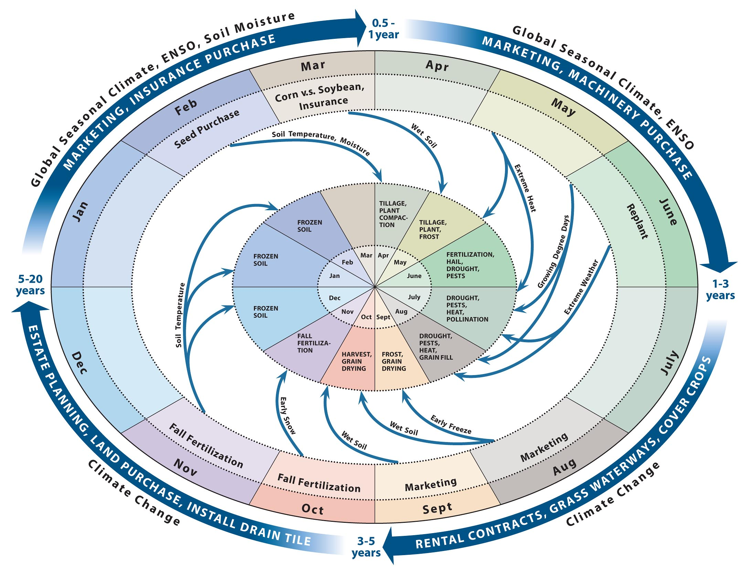
Climate-Informed Decision Cycle: Example - Corn Production in the Midwest
Draft Version
E.S. Takle

Slide 36
For More Information:
Climate Science Program
Iowa State University
http://climate.engineering.iastate.edu/
http://www.meteor.iastate.edu/faculty/takle/
gstakle@iastate.edu

